Slide 1
Women on web
Matteo Cernison, Camilo Cristancho, Simeona Petkova, Burak Dogu

Slide 2
Research Questions
What is the source distance of Women on Web for queries related to their purpose in the national webs of their target population?
For what queries are they prominent actors?
Are abortion pill vendors competitors to WoW in the national webs of their target population?
What is the ‘pace’ for the WoW queries in the national webs?

Slide 3
Case selection - South american target population
Brasil, Argentina - largest countries (spanish and portuguese)
Peru, and Bolivia - Medium and small national webs by internet users
37.8 %
64.4 %
27.0 %
11.1 %

Slide 4
Query design
How does ‘Women on Web’ site define abortion?
They Define it as:
unwanted pregnancy
unsafe abortion
safe abortion
medical abortion
illegal abortion
abortion rights
abortion pills
How does ‘Women on Web’ site define abortion?
They Define it as:
unwanted pregnancy
unsafe abortion
safe abortion
medical abortion
illegal abortion
abortion rights
abortion pills
Women on Web
Women on waves
Not in google.com top 100

Slide 6
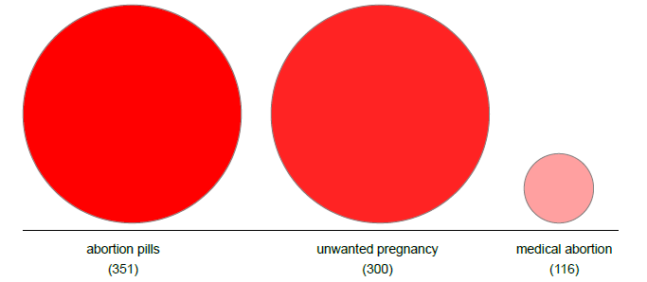
Prominence of WoW abortion issues (google.com)

Slide 7
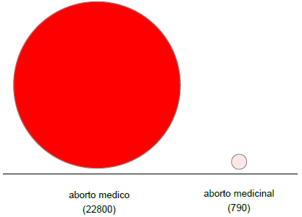
“medical abortion” – translation issue google.br # of returns

Slide 8
Women on Web vs. Fake vendors resonance in national webs

Slide 9
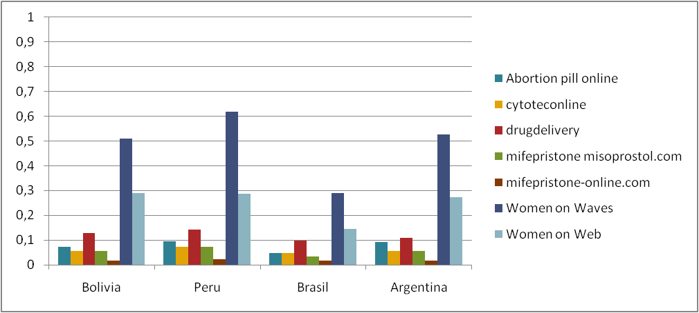
Query – unwanted pregnancy

Slide 10
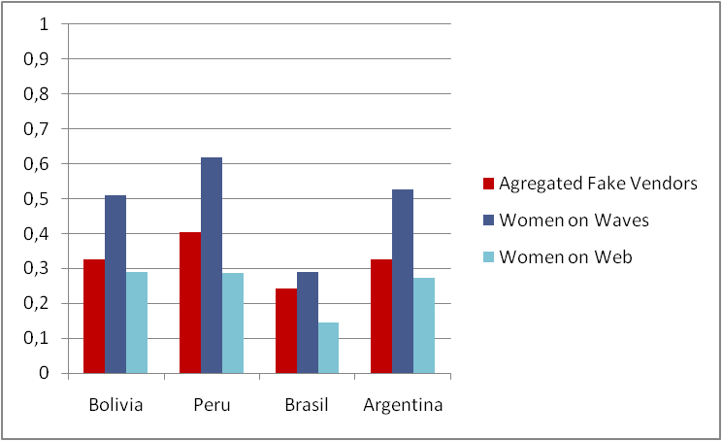
Unwanted pregnancy

Slide 11
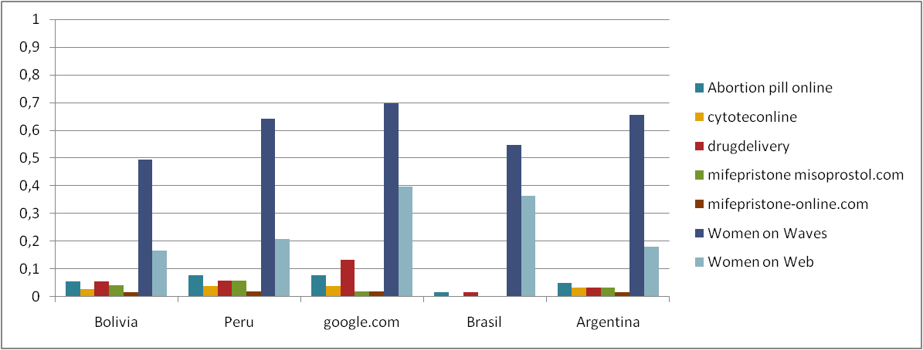
Query – “Abortion pill”

Slide 12
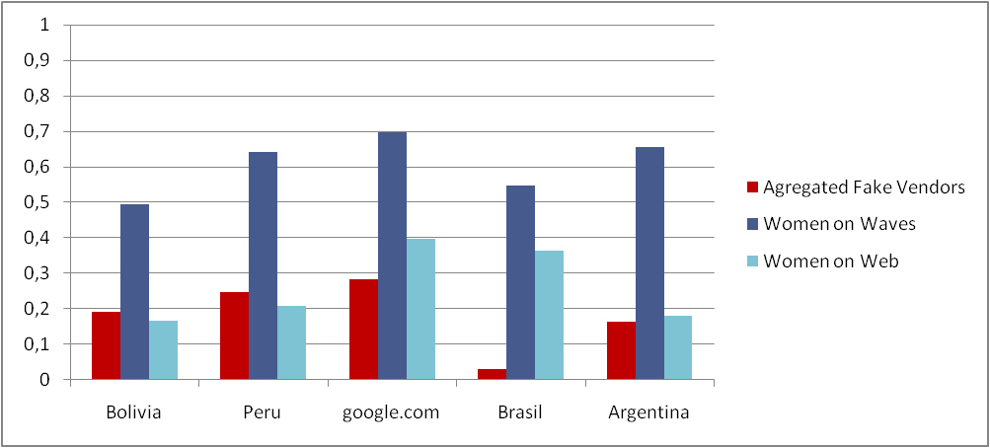
Query – “Abortion pill” Aggregated vendors

Slide 13
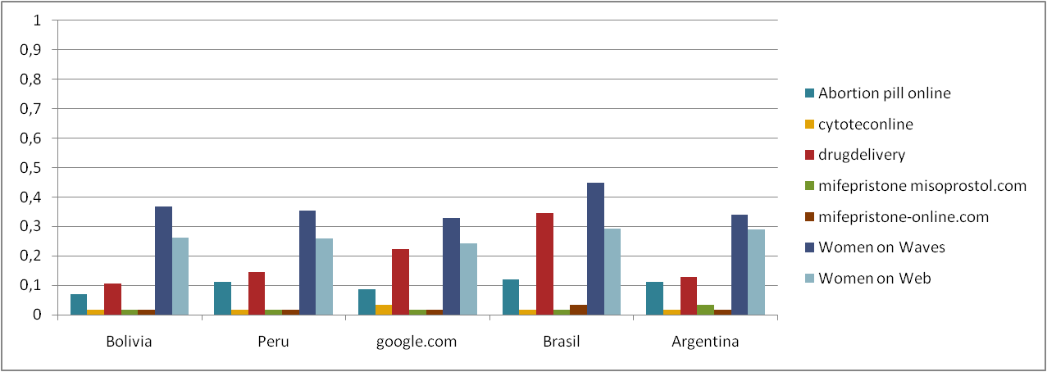
Query - mifepristone OR cytotec OR RU486 OR misoprostol

Slide 14
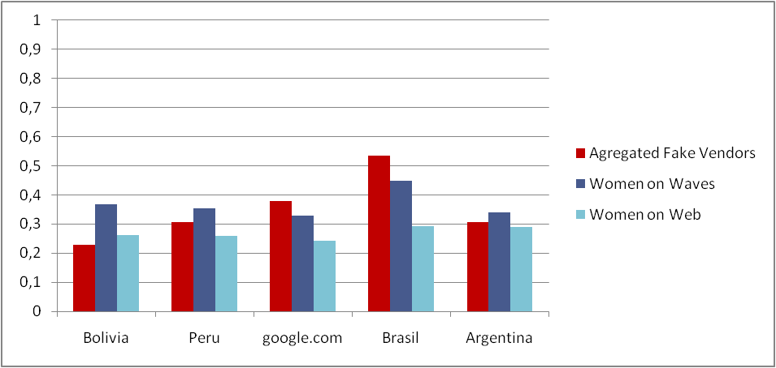
Query - mifepristone OR cytotec OR RU486 OR misoprostol Aggregated vendors

Slide 15
Local terms and WoW concept of “medical abortion”

Slide 16
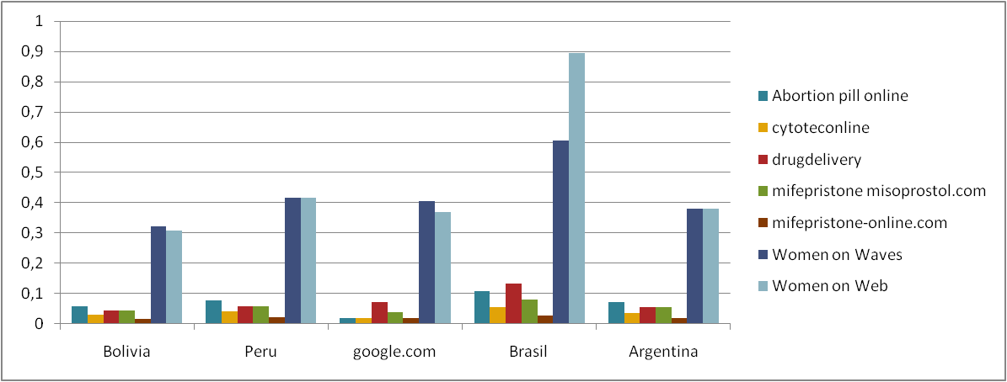
Medical abortion
Aborto
medicinal
Aborto
medicinal
Medical
abortion
Aborto
medicinal
Aborto
medicinal

Slide 17
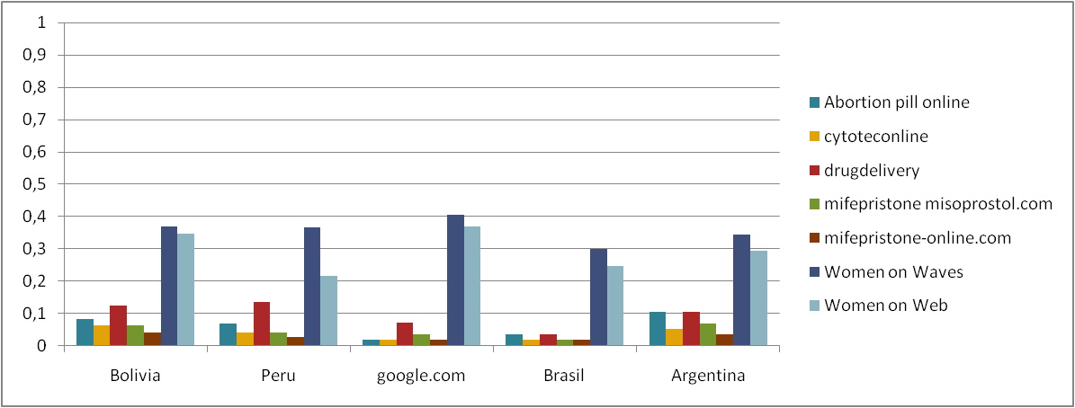
“Aborto Médico”
Aborto
médico
Aborto
médico
Medical
abortion
Aborto
médico
Aborto
médico

Slide 18
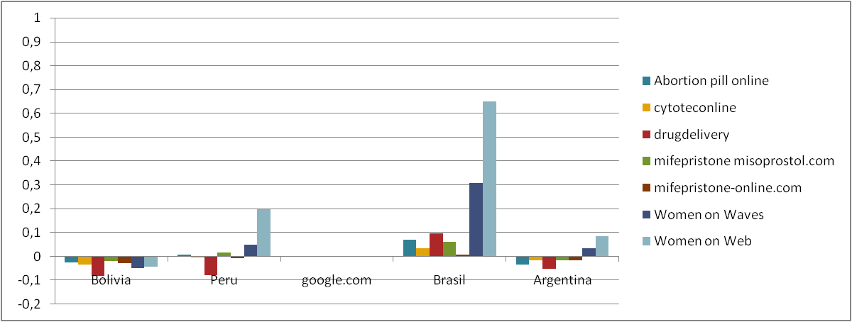
Difference between “aborto medicinal” and “aborto médico”

Slide 19
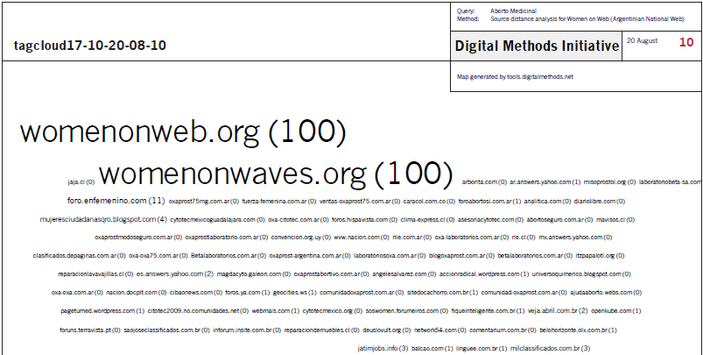
Query – “aborto medicinal” Source distance WoW [.ar]

Slide 20
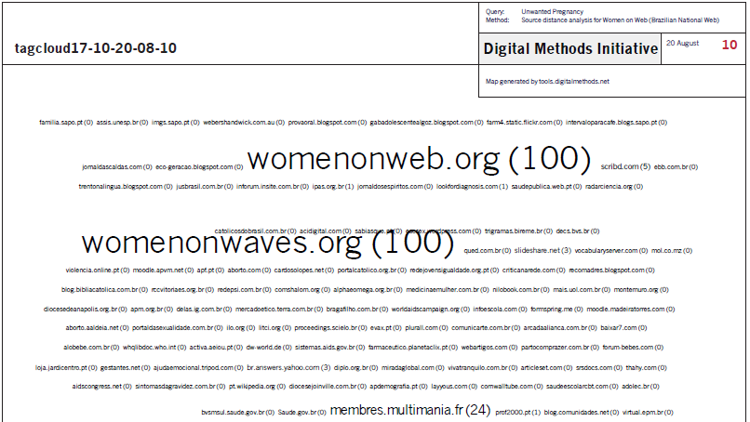
Query – “Unwanted pregnancy” Source distance WoW [.br]

Slide 21
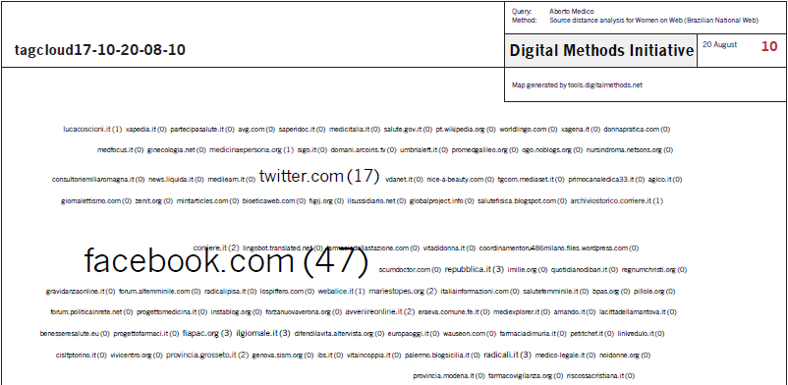
Query – “aborto médico” Source distance WoW [.br]

Slide 22
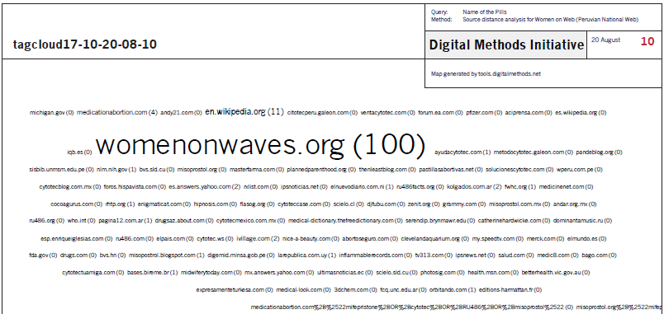
Query - mifepristone OR cytotec OR RU486 OR misoprostol Source distance [.pe]

Slide 23
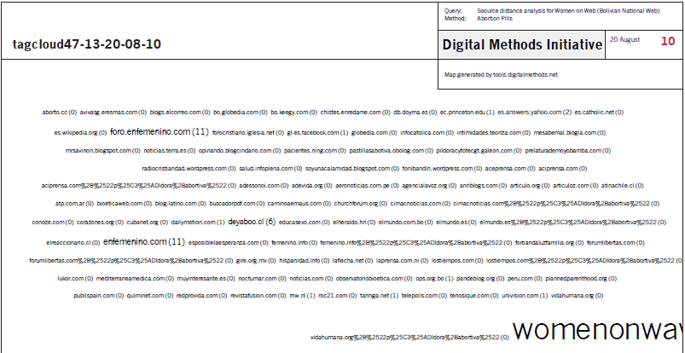
Query – abortion pills Source distance [.bo]

Slide 24
WoW vs. Vendors - Top 5 results

Slide 25
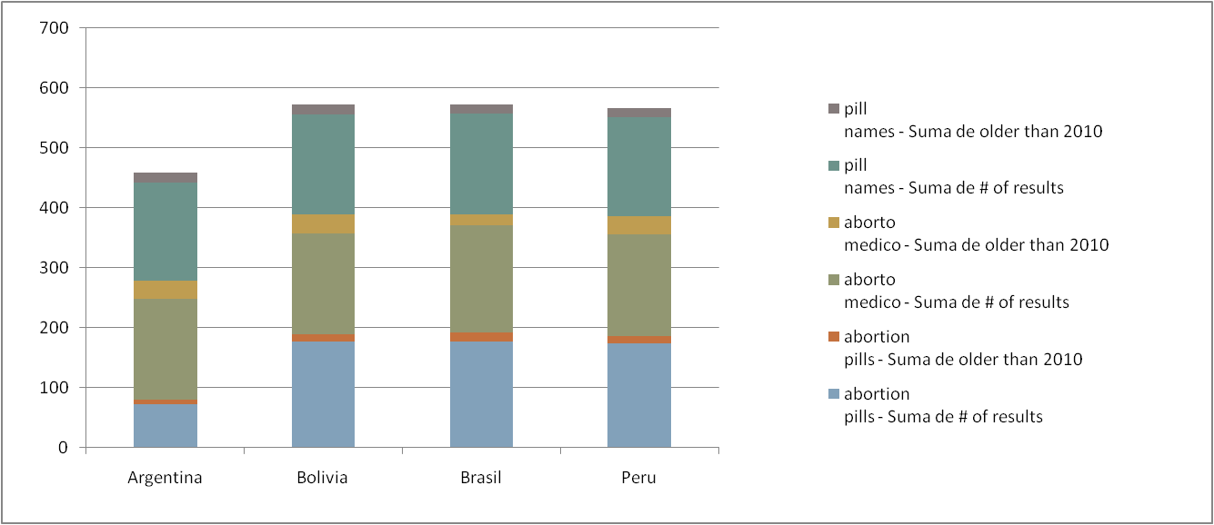
Issue freshness – time stamps
Pill names – older than 2010
Pill names
Aborto médico – older than 2010
Aborto médico
Abortion pills – older than 2010
Abortion pills

Slide 26
Contributions Space & National Webs
Countries in South America share sources and similar information patterns (based on 4 queries and their resonance)
Countries in South America rather share a language Web than having national Webs demarcated by Google (.ar; .bo; .br; .pe)
In Top 5 results across the four national Webs both local and global sources are present
4. National Webs per these issues are well up-to-date in terms of Years

Slide 27
Further Research:
Contextualize Women on Web using the issue ‘Abortion’ and its global sub-definitions and actors
Look up in social media for discussions (Facebook’s pages on abortion in English are not very big/dynamic);
Results in Brazil listed as a prominent issue space for the query ‘aborto medico’ even though they were listed near the bottom results
Look up for the prominence of the fake? vendors we have discovered

Slide 28
Thanks

Slide 29
TIME STAMPS
 | Brazil
Keyword | "pilulas abortivas" | "aborto medico" | "aborto medicinal" | names of pills | TOTAL
# of results | 178 | 179 | 162 | 169 | 688
older than 2010 | 14 | 18 | 4 | 15 | 51
 | Argentina
Keyword | "pildora abortiva" | "aborto medico" | names of pills
# of results | 72 | 167 | 163 |  | 402
older than 2010 | 9 | 31 | 17 |  | 57
 | Peru
Keyword | "pildora abortiva" | "aborto medico" | names of pills
# of results | 175 | 169 | 166 |  | 510
older than 2010 | 12 | 30 | 14 |  | 56
 | Bolivia
Keyword | "pildora abortiva" | "aborto medico" | names of pills
# of results | 177 | 168 | 167 |  | 512
older than 2010 | 12 | 32 | 16 |  | 60

Slide 30
Time stamps
 | 2010
 | older than 2010
Brazil
Argentina
Peru
Bolivia

Slide 31
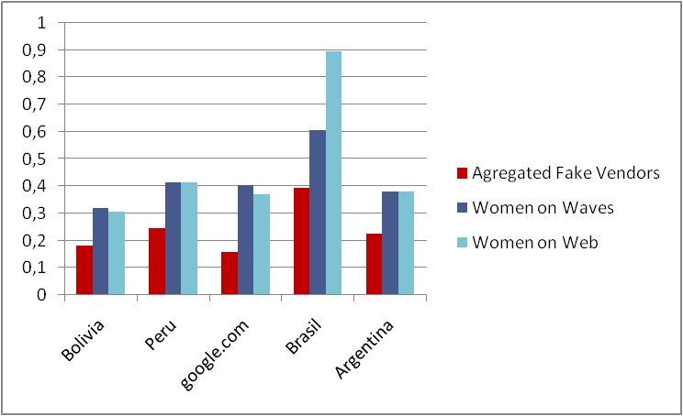
Medical abortion Aggregated vendors

