Slide 1



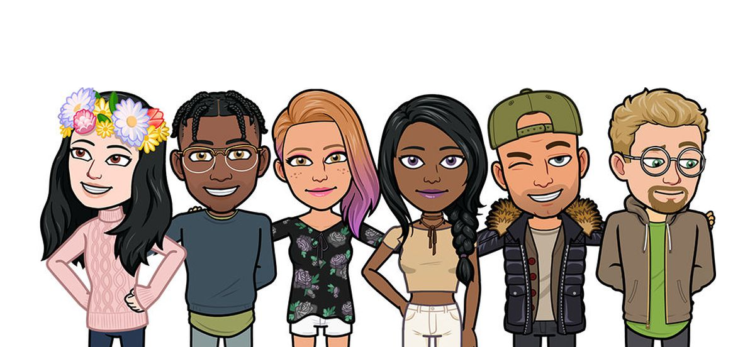
K-Community Ideas
What we can learn from other platforms
Rushil Ahluwalia
k20062105

Slide 2

Big picture
Building an eco-system : socializing and shopping
Making community one of the apps a user engages with daily
Creating a unique social space

Slide 3
Environmental Scanning
Shift from TV to mobile phones: Young consumers are spending more time with mobile video every year. In 2020, nearly 3 in 4 Gen Zs and Millennials report that they watch more video on their smartphones than they did a year ago.
85% of Gen-Z are watching video content on their smartphones: The impact of COVID-19 on mobile video consumption is significant. Mobile video is up 4% in March 2020 and has been increasing since, compared to pre pandemic days, and now accounts for more than half of all mobile traffic. Despite added TV time for Gen Z and Millennial consumers while isolating at home, younger generations are still prioritizing mobile video.
Consuming content on smartphones is the new WAVE

Slide 4
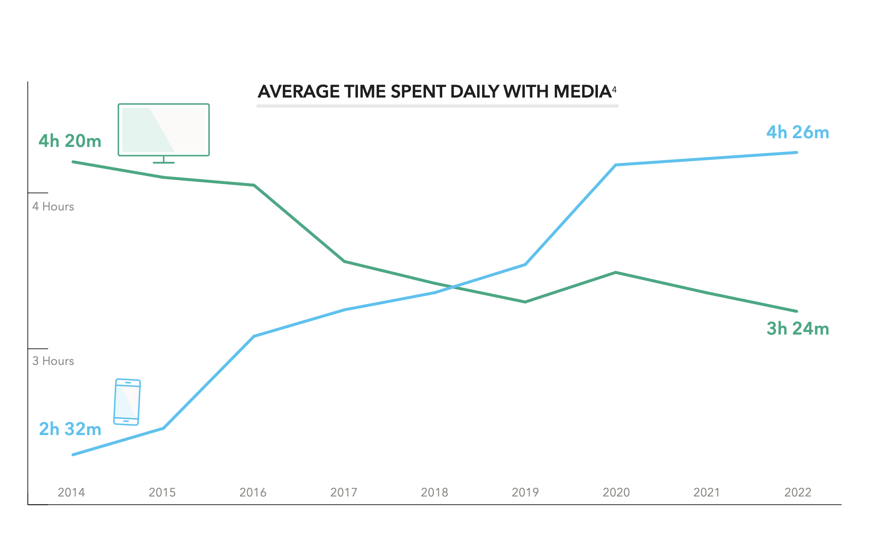

Slide 5
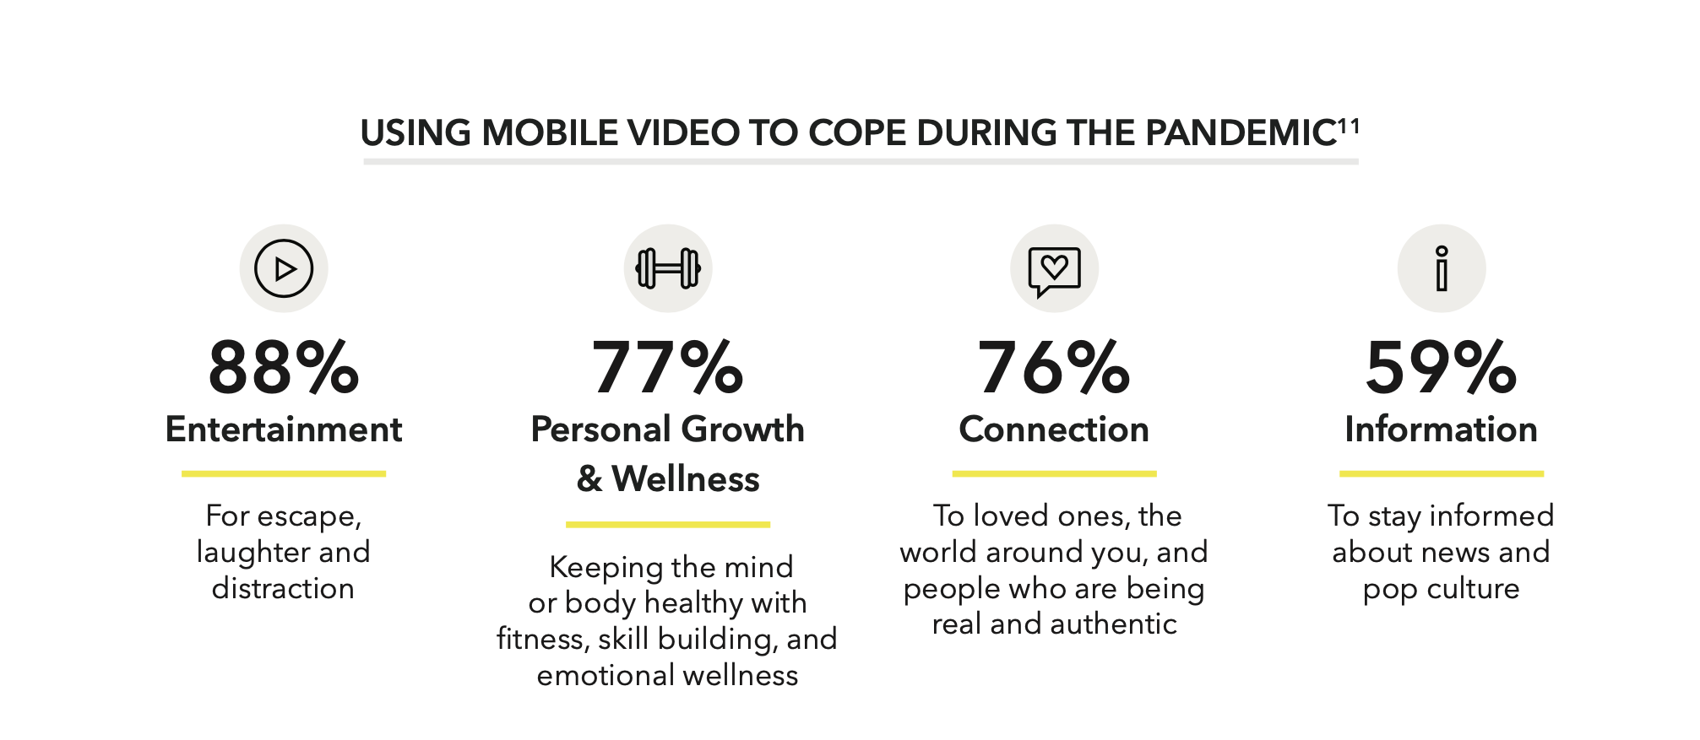
Mobile video : Biggest player in the attention Economy

Slide 6
Current Social Media Trends
Younger generations have shorter attention spans
Lots of attention is given to user created content
We are living in an era of Short videos (Reels / TikToks)
What makes them appeal to younger audiences: Storytelling , relatable , quick access , quirkiness

Slide 7
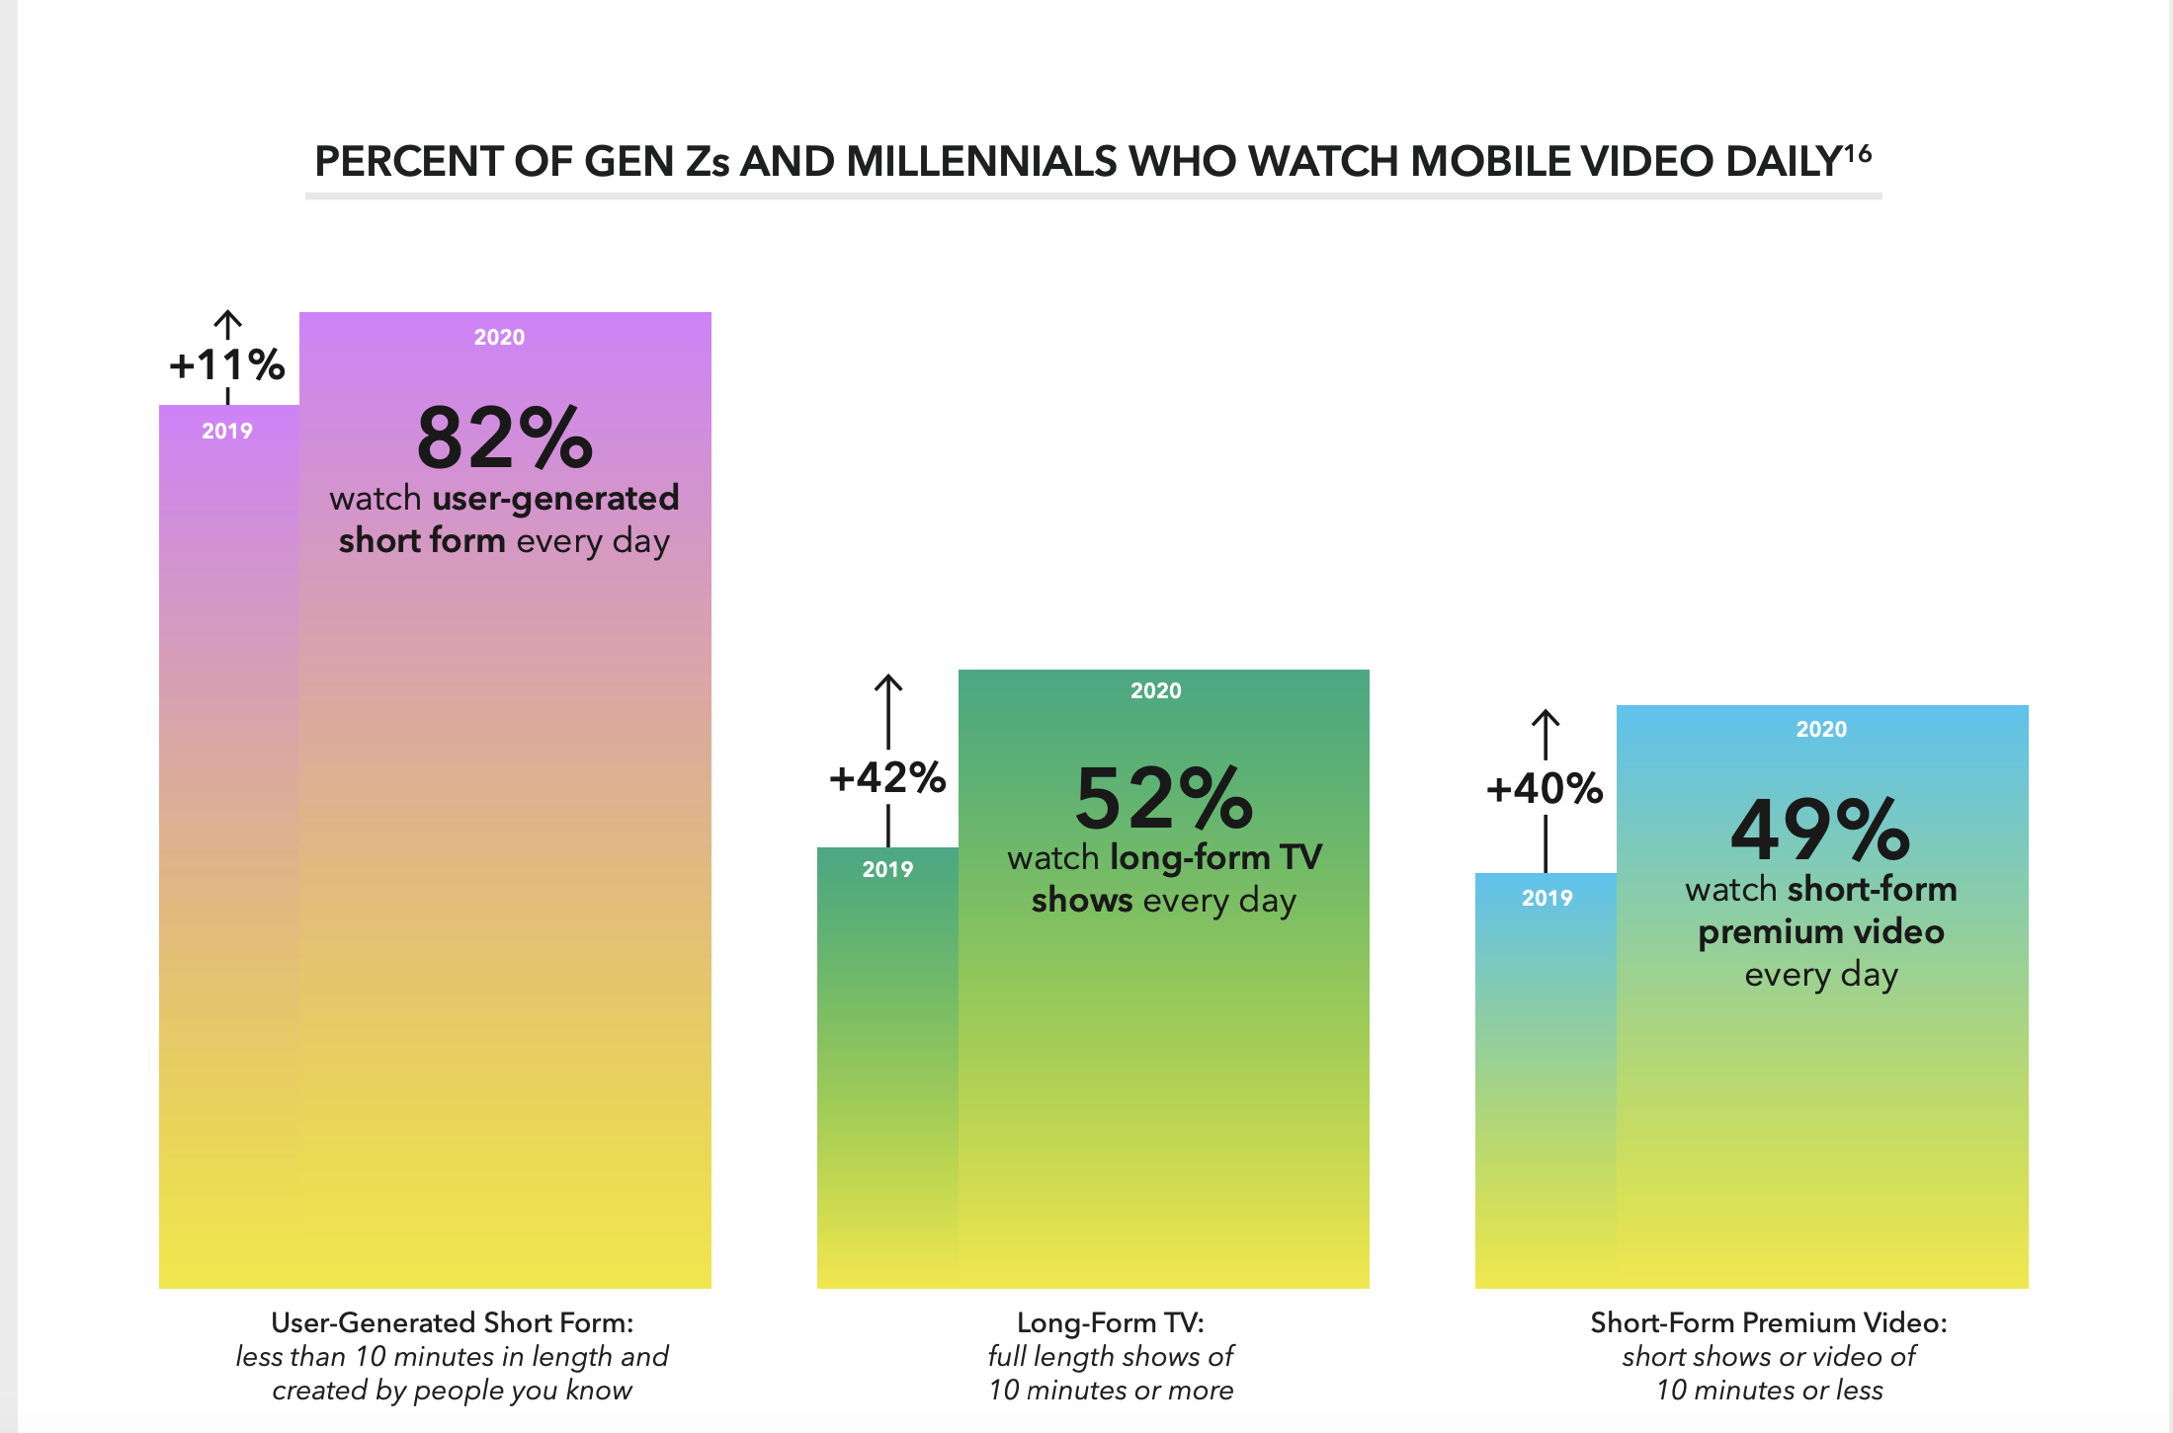

Slide 8
Research Method
Critically analyzing one of Gen’z favorite platform : Snapchat
Conducting a ‘walkthrough’ of snapchat
Looking for UI features and engagement activities of the app which make it unique and addictive
Additional: How snapchat is adopting to the metaverse

Slide 9
Observations from Snap Walkthrough
Snapchat has successfully created social eco-system of a ‘second life’
Users are identified solely by their ‘bitmojis’
Easy to use & addictive User-Interface
App offers a very lively environment
Lots of incentives are given to the user to engage with the platform daily
Adapting to the metaverse
Filled with X-Factors which makes it unique

Slide 10
3 Pillars of an Engaging Mobile Video Experience
PERSONAL
SHAREWORTHY
RELATABLE

Slide 11
PERSONAL
Create a ‘just for me’ experience , in a convenient format which offers flexibility
Vertical full screen display: a more immersive experience
Own unique identity
Good FYP

Slide 12
SHAREWORTHY
The drive to make content and share with others (endless loop of content = unlimited assets)
A space where users can express themselves : The video content Gen Zs and Millennials engage with is a reflection of who they are
Social Creds : Life may be shit but if your social looks good and you have clout : how your real life is going doesn’t really matter
When a user shares content on a public space : say it’s well received, it can boost their confidence and make themselves feel better about themselves

Slide 13
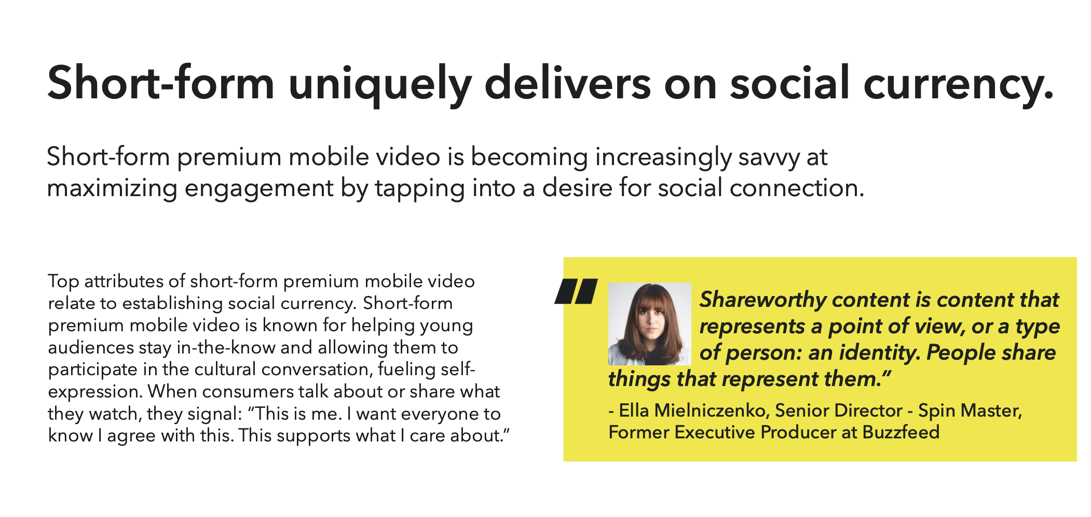
SHAREWORTHY

Slide 14
RELATABLE
Need to show the consumer just what want & when
Best way to keep users engaged is to create an environment to which they can relate
They should feel in place on our platform
Hyper-relevance=Hyper-connectivity

Slide 15
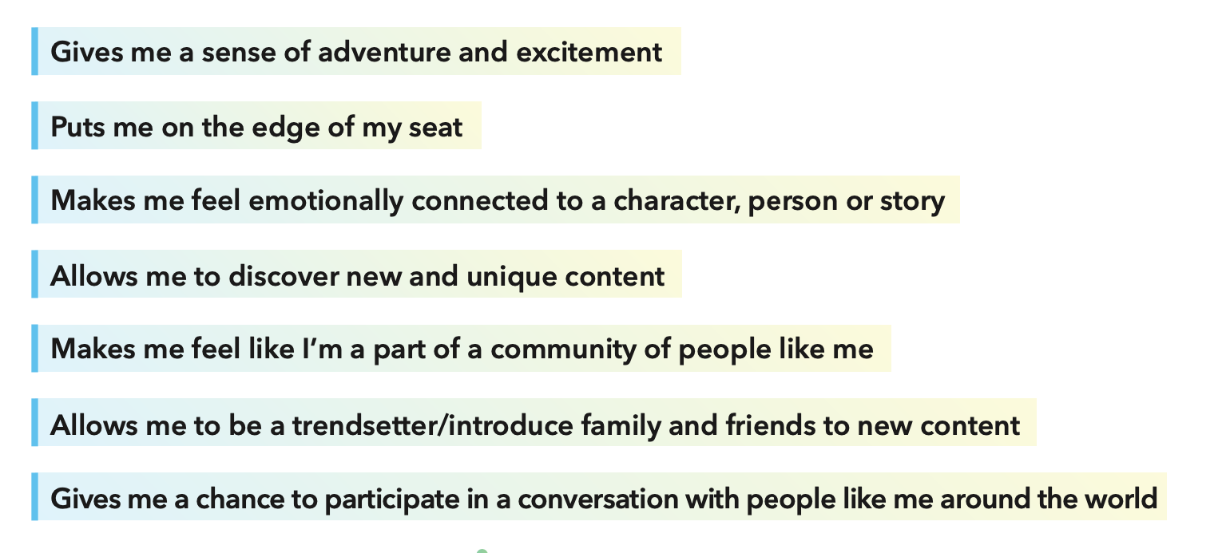
TOP DRIVERS OF ENJOYMENT & ENGAGEMENT FOR PREMIUM MOBILE SHORT-FORM

Slide 16
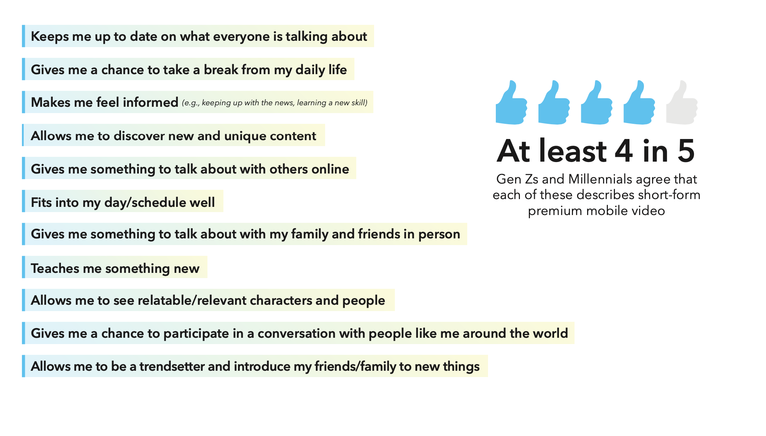
TOP ATTRIBUTES OF A VIDEO PLATFORM

Slide 17
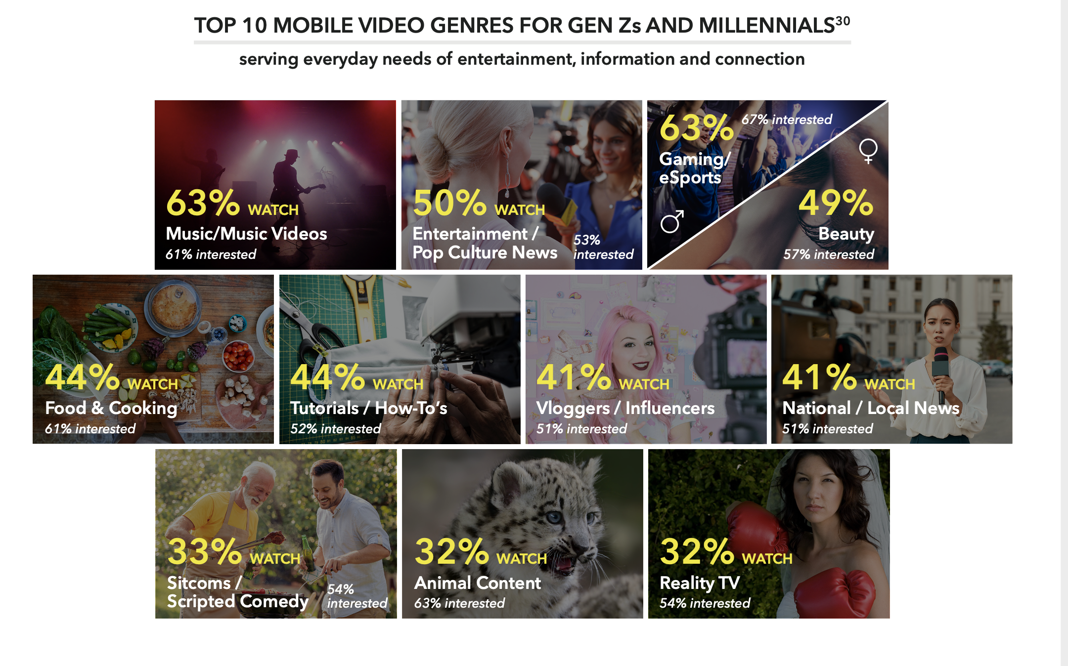

Slide 18
PROFILE
No first name + last name – Users should be able to choose their display name (followed by a serial name which makes it unique)
Must collect more data from users
Profile should be more in-dept – Enough to speak about user’s personality
Benefits : 1. Helps other users find people of their kind
2. More data we have on users, better targeting ads of our products

Slide 19
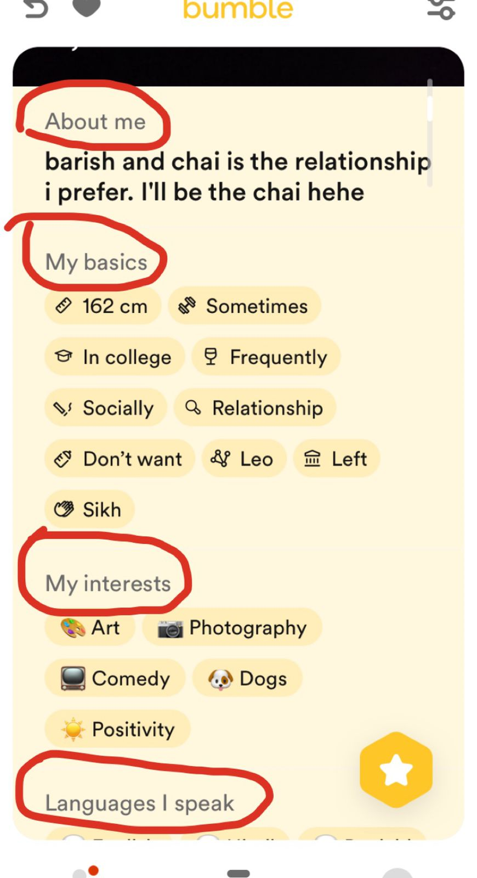
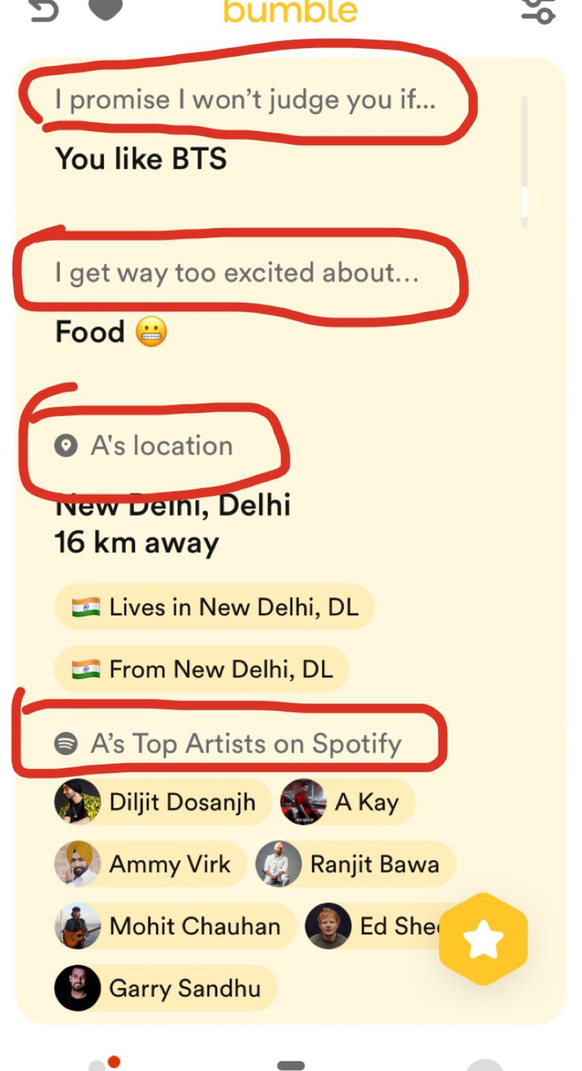
Bumble profiles

Slide 20
METAVERSE ADAPTABILIY
Adding web 3 like elements to community
P2E: Play to earn. Add activities and mini games which users can play with friends to order kinders
Unique Avatars with in-dept customization (including LTM items, rare unlockable items, time sensitive items)
Introduction of non-monetary kinders which users can earn by using the community and shopping. Non-monetary kinders can be used to customize avatars.
Shop together feature ( discounts to incentivize)
GRWM rooms
Daily log-in bonuses
VR Store

Slide 21
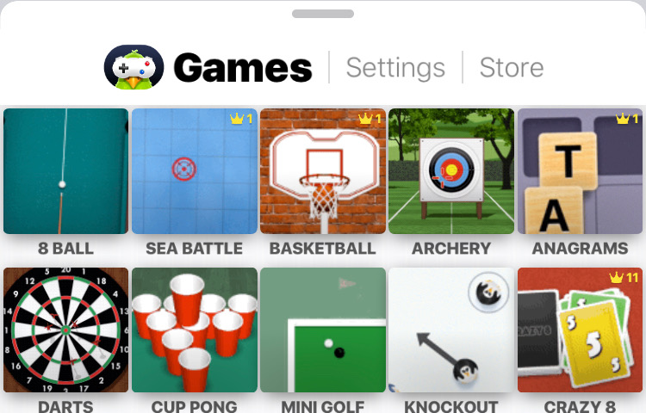

P2E Games Examples
Notes:
Users can earn kinders for playing and winning these games

Slide 22
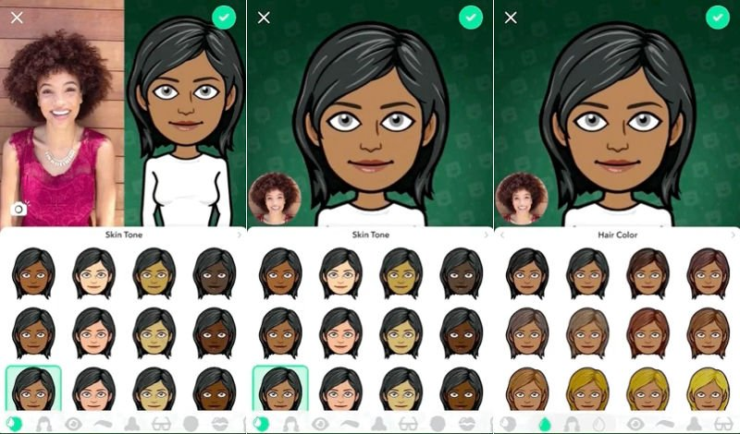
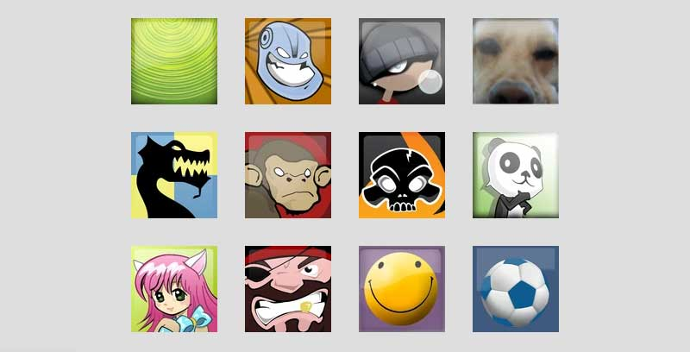
Avatar Creation Ref
Standard avatar selection (xbox360)
In-dept like Bitmoji

Slide 23
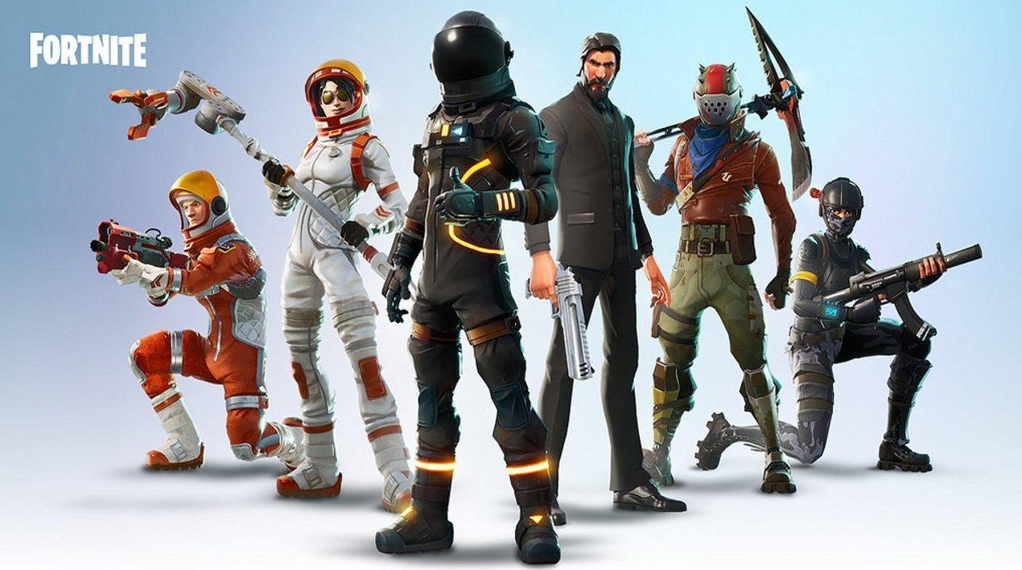
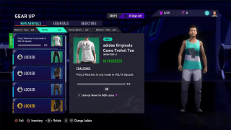
Rare Avatar Items
Fortnite battle pass skins can only be earned during that season. One must complete all 100 levels to get all skins. Once the season is over, the skin cannot be acquired
Volta adding seasonal and limited clothing
for avatars. Can only be earned during that
given timeframe.
Notes:
Non-monetary kinders can be redeemed for character customisation

Slide 24
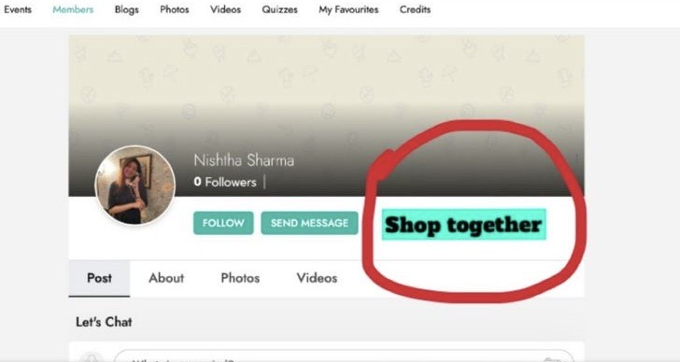
Shop Together feature
Voice chat channel when users can share screens with their friends and shop together
Objective: Add the ‘mall like experience to our platform’
Execution :
Notes:
Users can host a session by hovering on their friend’s profile

Slide 25
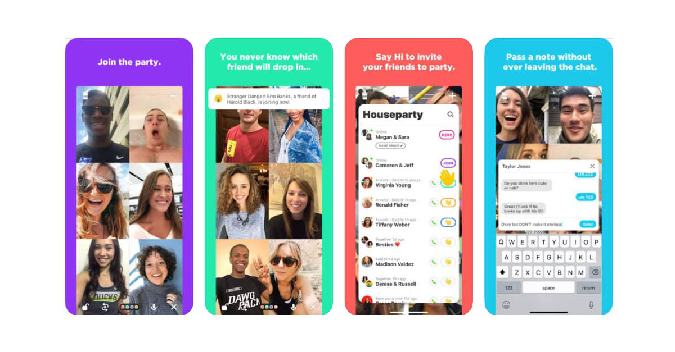
Get Ready With Me Feature
Similar to houseparty. Users create a
Room and can add one or more friends to it as they do their make-up, skincare etc.
We can easily leverage kindexperts for this feature. Host paid sessions with our in-case MUAs and skincare experts

Slide 26
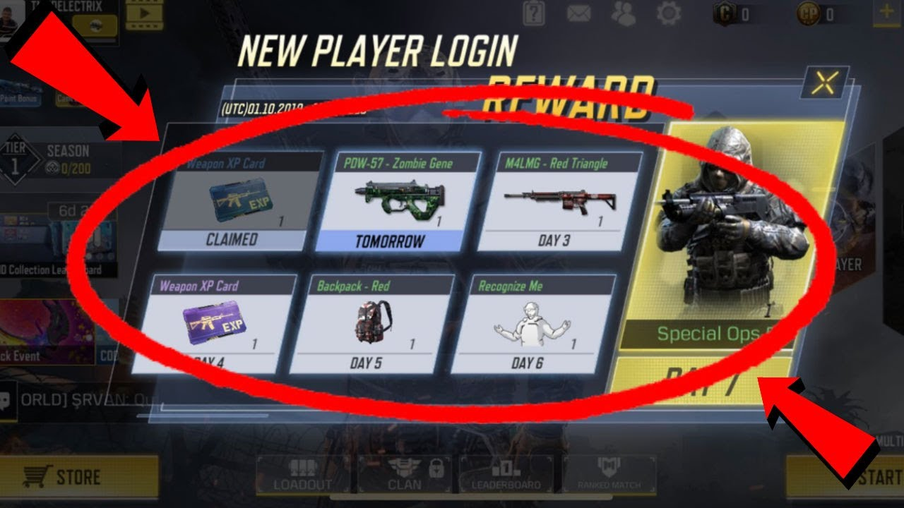
Daily Login Bonuses
Notes:
Players of the game codm receive freebies for simply hoping onto the app everyday. Effective method to maintain active user-base

Slide 27
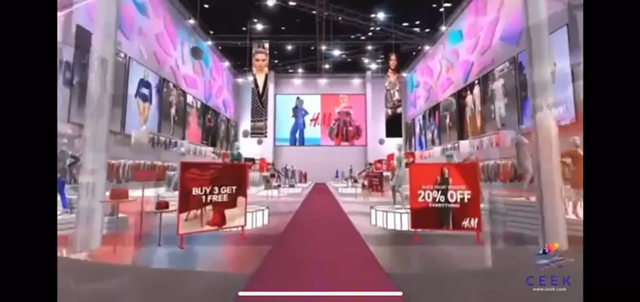
VR Shop : H&M in the metaverse

Slide 28
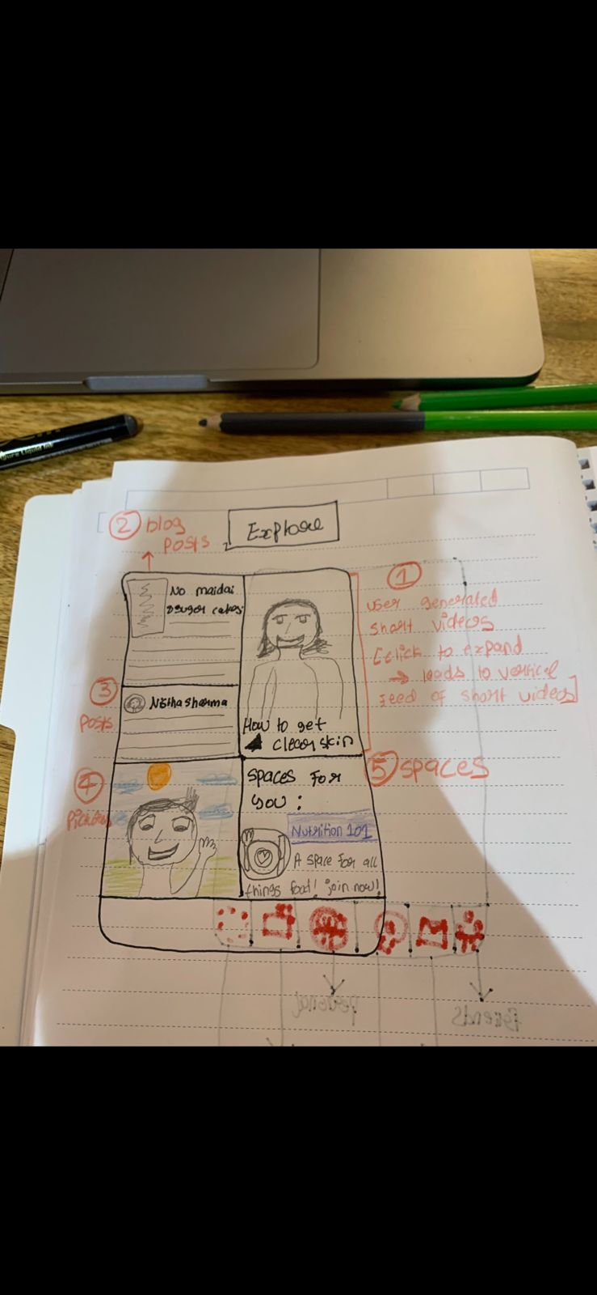
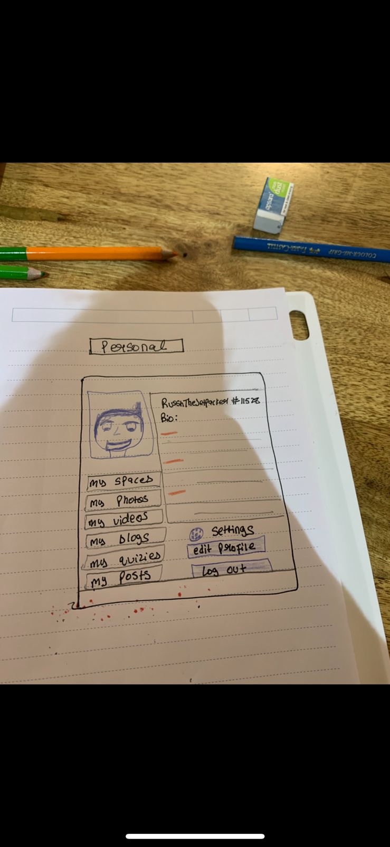
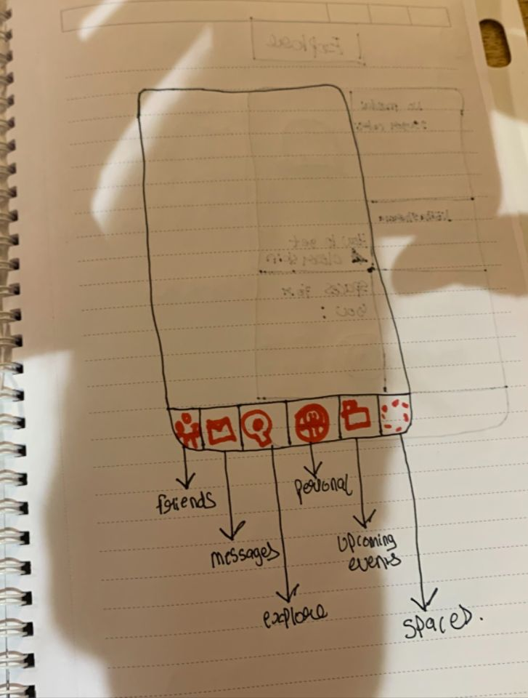
New UI/UX Look for Community (skeleton)

Slide 29
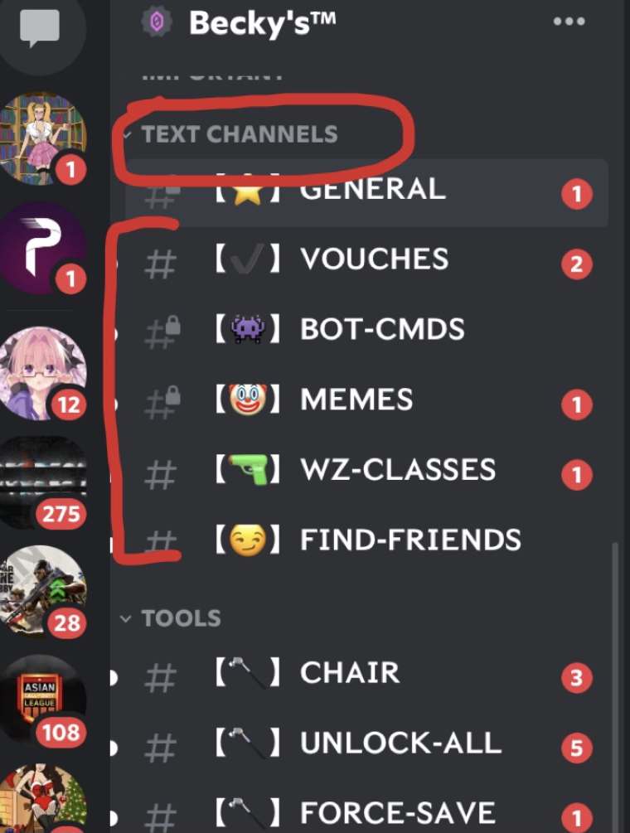
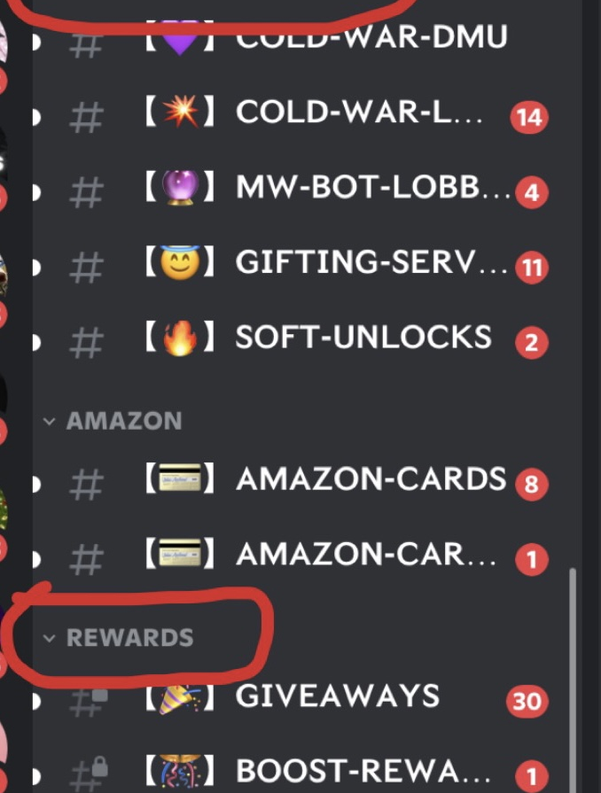
Discord’ UI/UX
It’s really organized and user-friendly
Prefect for us to use for our ‘spaces’

