Slide 1
Investigating Issues on
Facebook
Clare Lee, Lonneke van der Velden, & Esther Weltevrede

Slide 2
Background
Facebook isn’t designed for activism (digiactive.org)
Assumption of a low level of “actual” engagement: “slacktivism”

Slide 3
Questions
What can Facebook “do” for issues?
What kinds of issues are prevalent on Facebook?
What action formats do Facebook groups promote?

Slide 4
Testing the waters…
Get a feel for the ‘issue climate’ on Facebook:
Use Google to query page and group titles for human rights keywords from NGO sources
site:facebook.com/group intitle:KEYWORD

Slide 5
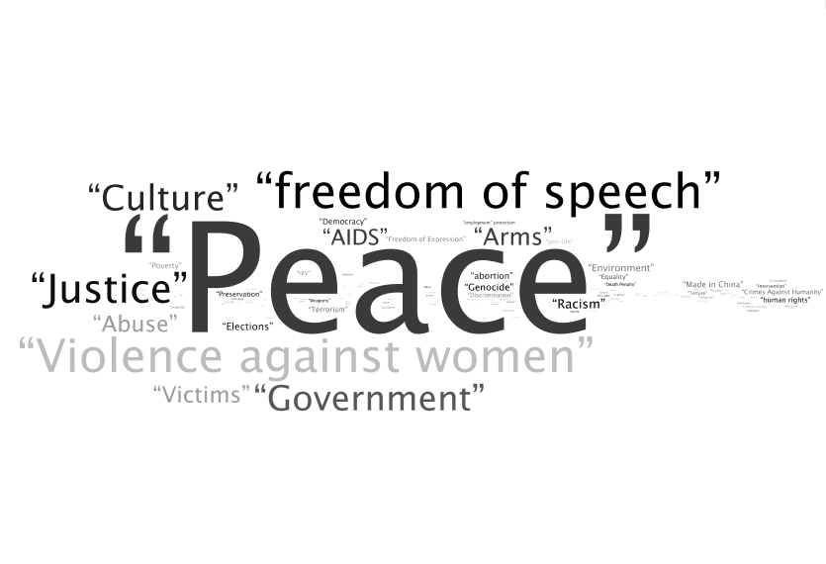

Slide 6
Stance Language
We questioned whether there might be more Facebook-specific ways of phrasing groups than a dry list of NGO keywords…
Investigate ‘stance’ keywords in page and group titles:
“anti ” OR “anti-” | against | stop | protest | opposition | oppose | resistance | resist | halt | refuse | “object to” | objection | “pro ” OR “pro-” | support | help

Slide 7
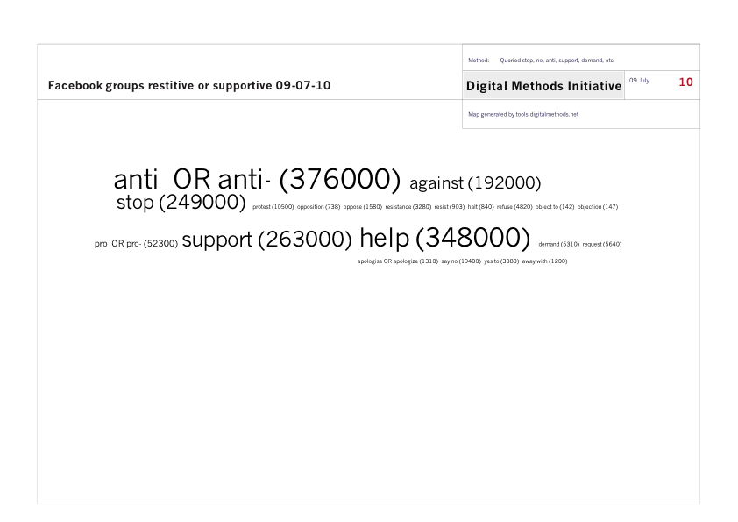

Slide 8
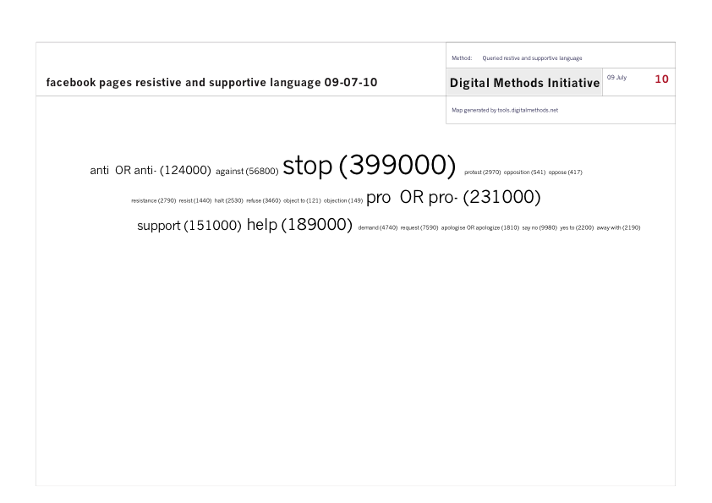

Slide 9
Who’s on top (of Google, not Facebook)?
Scrape Google for the top 100 groups for “anti”, “pro”, “stop”, and “support” in the title
Remove artefacts and query the top 35 for member count with “of * members”, a common, unique string on group pages to see which groups are the biggest

Slide 10
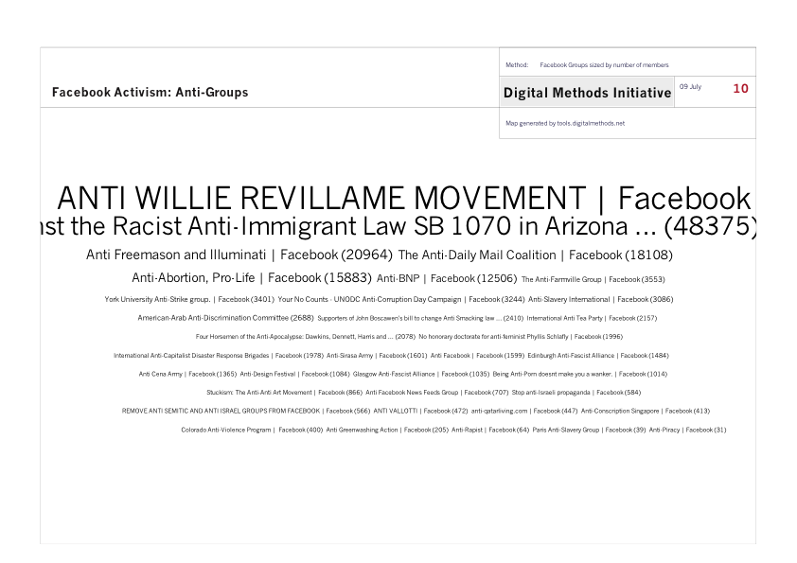

Slide 11
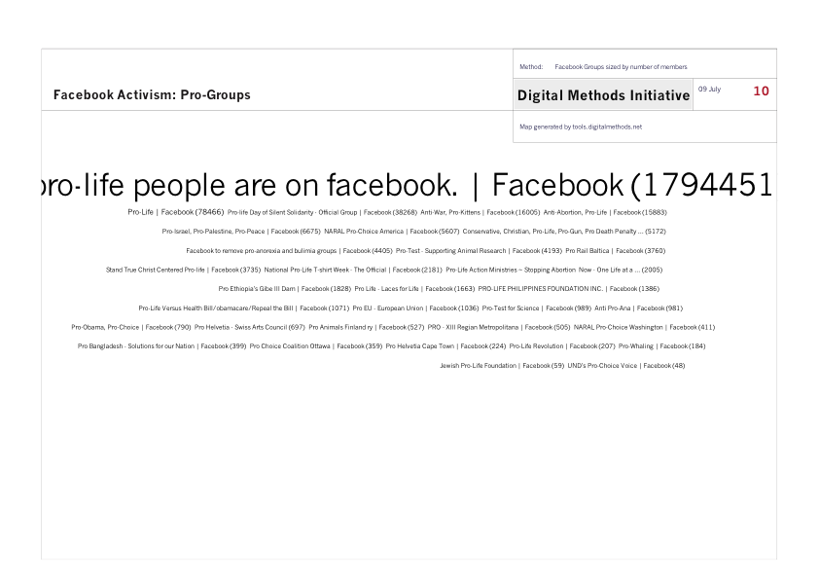

Slide 12
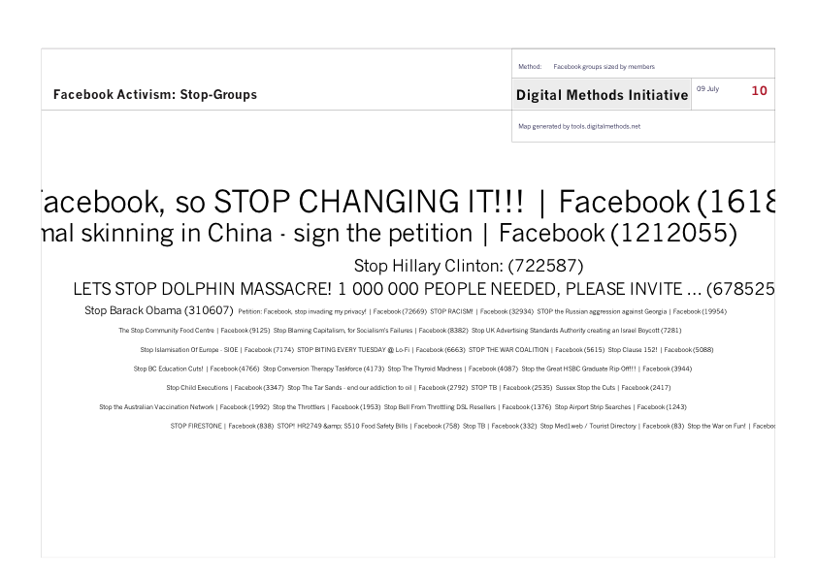

Slide 13
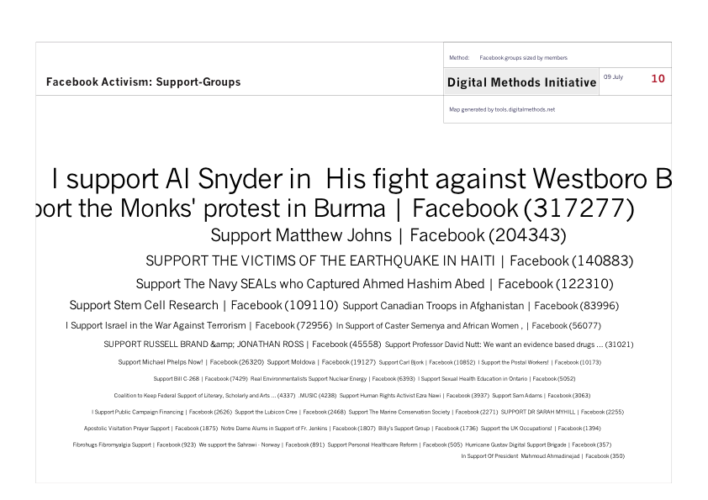

Slide 14
Defining the groups
Question
Data
Where does it fit in the Facebook framework?
What’s the group about? (actor position)
What action format does the group suggest?
Chosen Facebook category
Title/ Info keywords
Actor-defined calls to action

Slide 15
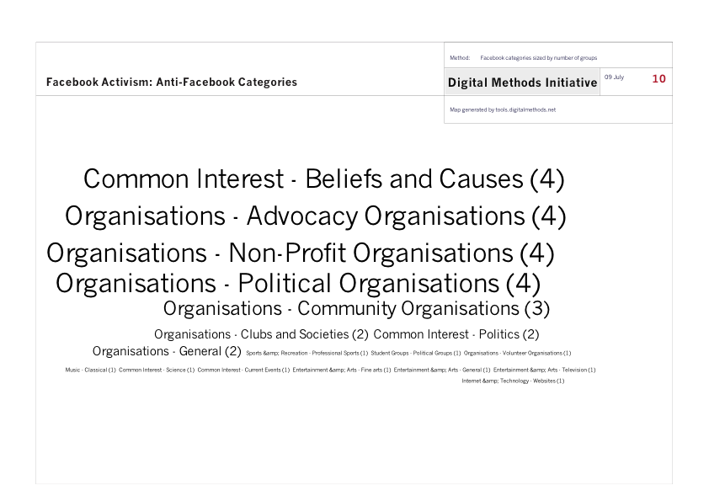

Slide 16
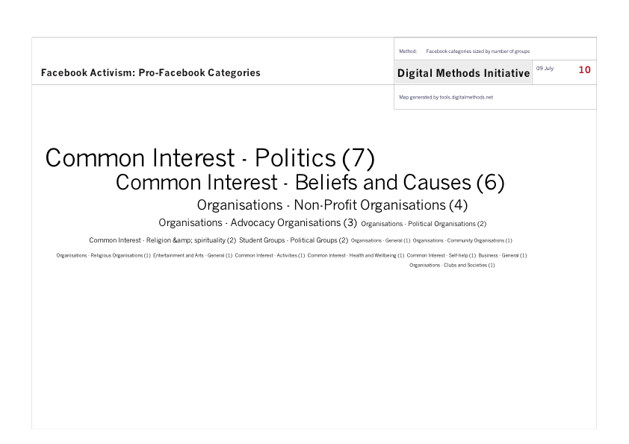

Slide 17
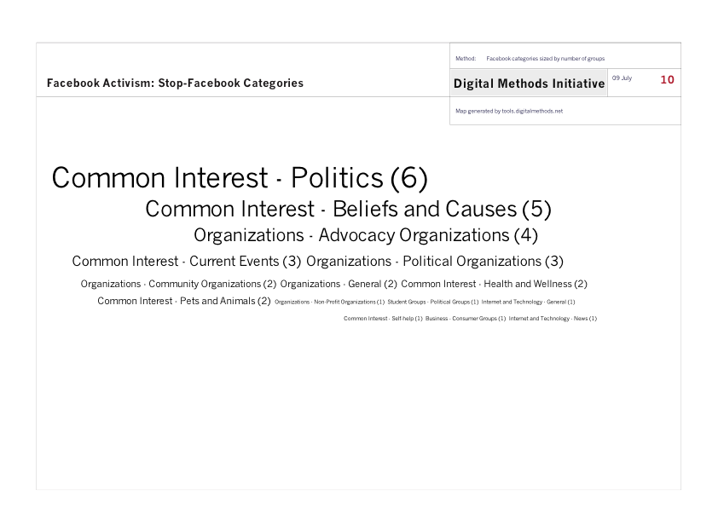

Slide 18
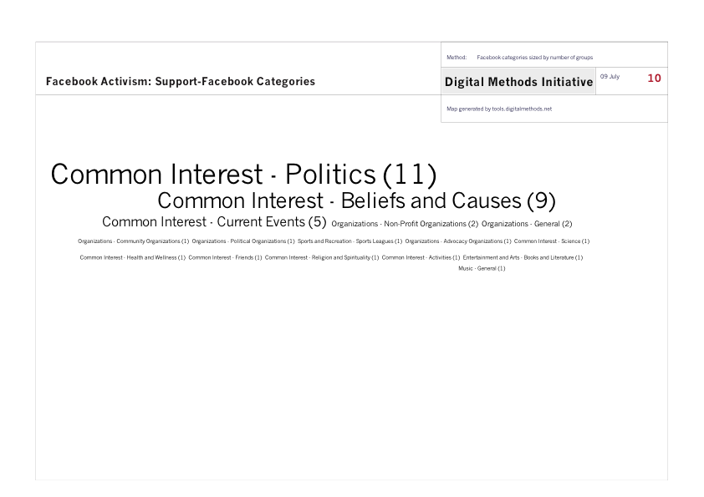

Slide 19
What do they care about?
Adopt the actor language to define their issues
Let meta categories emerge

Slide 20
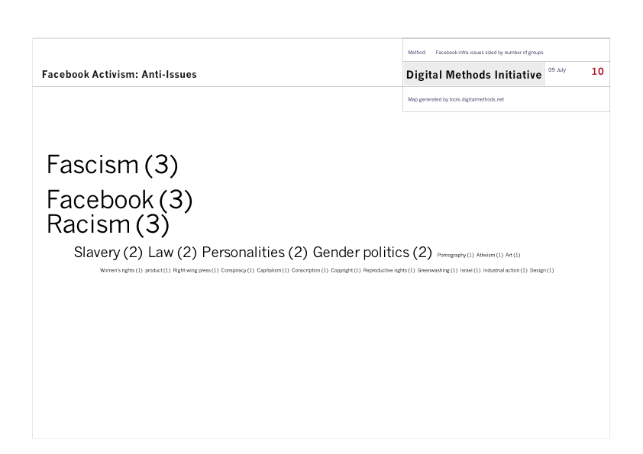

Slide 21
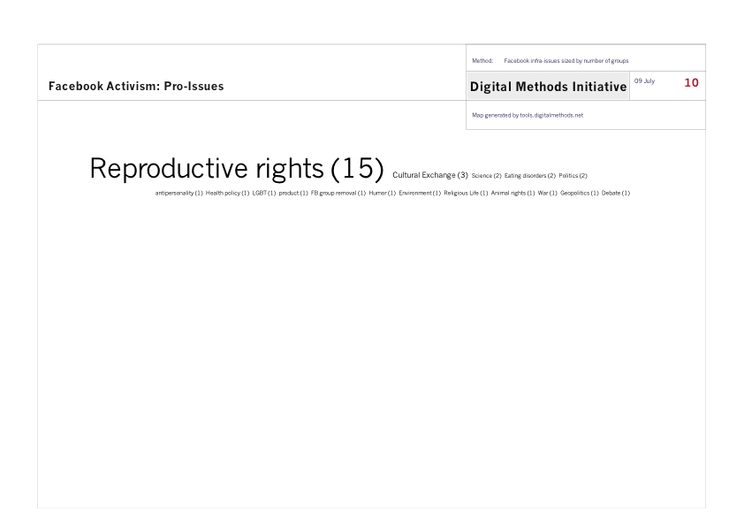

Slide 22
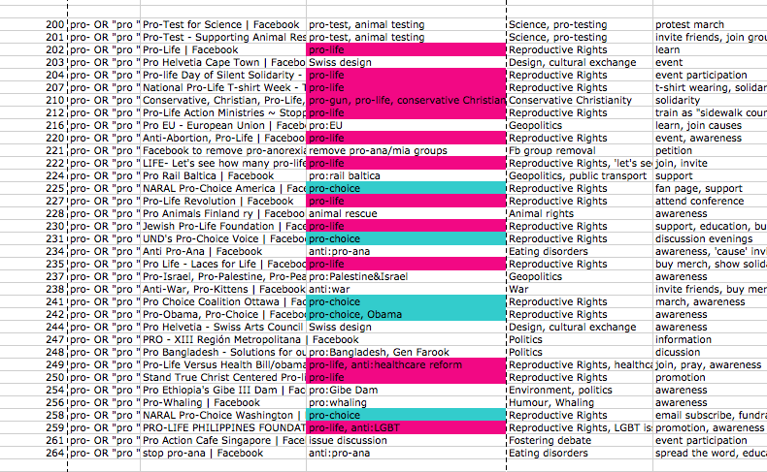

Slide 23
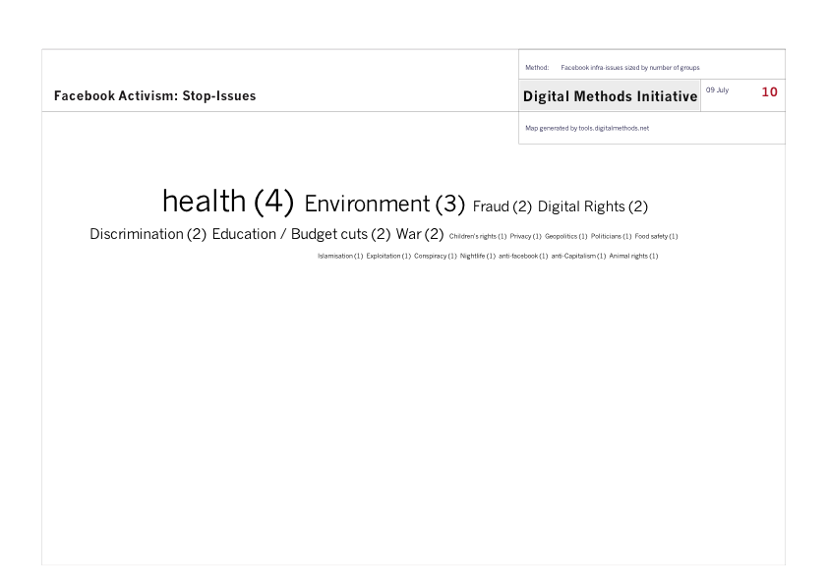

Slide 24
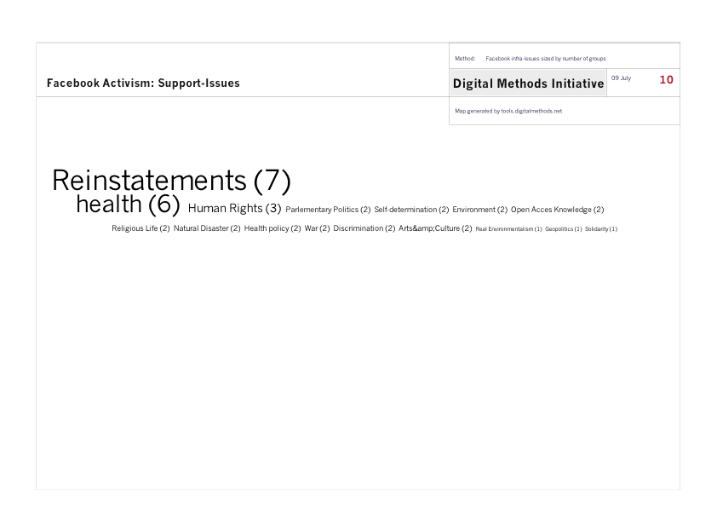

Slide 25
“Facebook activism is nothing, just a click…”
Attempt to find calls for action within Facebook groups, what kinds of action do the groups advocate?
Emerging infra-language from the actors’ own words
Collate into meta categories

Slide 26
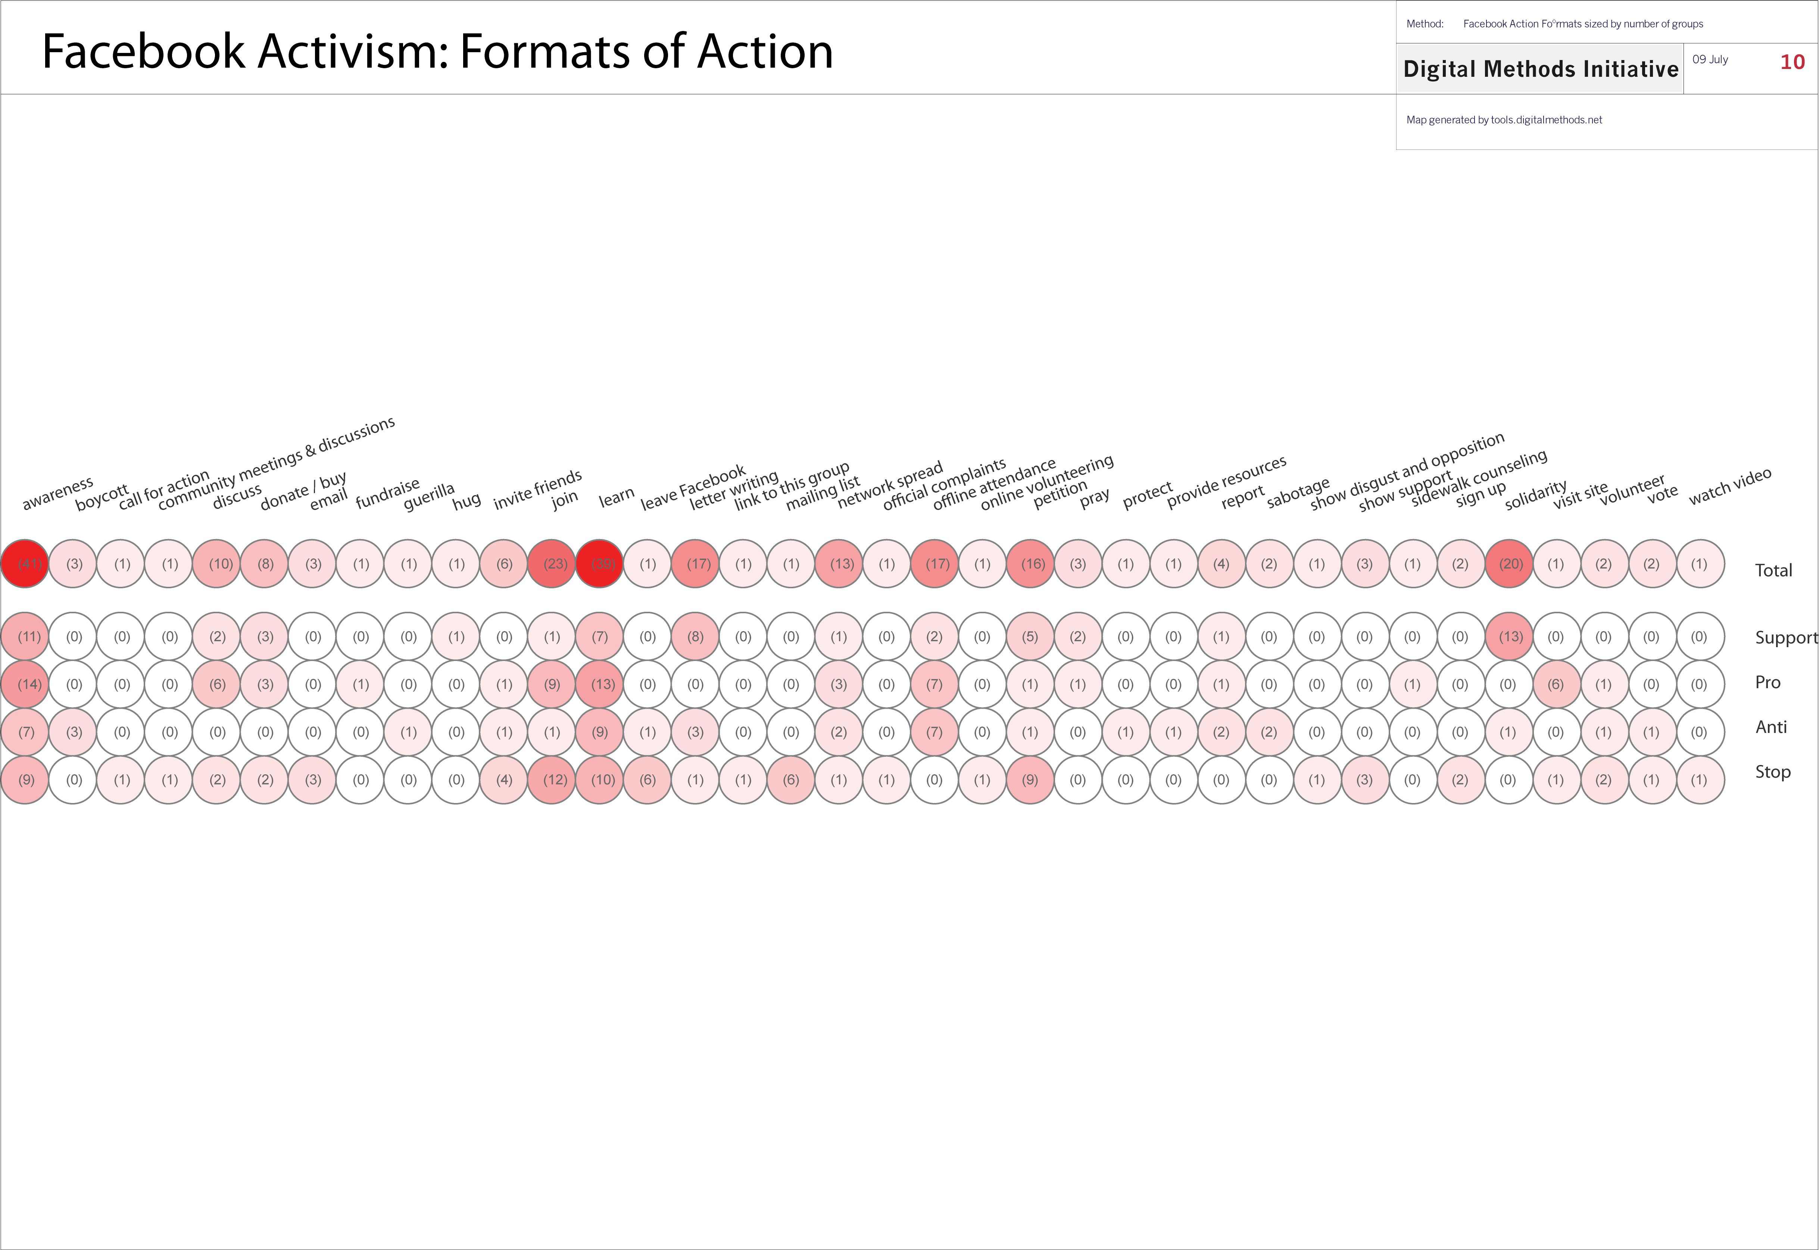

Slide 27
Action indications
Overall playing towards lightweight engagement and network spread features of Facebook (learn, join, awareness)
Anti: more action oriented, position of protest
Pro: awareness, spreading
Stop: joining & petitions – specific protests, short term, explicit need for names on paper
Support: solidarity, letter writing

Slide 28
Further exploration
Sample a much bigger set!
A measure of follow-through on what groups promote
Take our actor issues and see how prevalent they are, alongside NGO language, to get a better idea of what Facebook users care about
Explore the interlinking in issue areas (pro-choice/pro-life debate), Facebook field battles?
Query for sites connecting Facebook with issues to see to what extent Facebook is externally associated
ie. “pro-life” –site:facebook.com

